Slide 1
Methods of Infiltration
Module 3

Slide 2

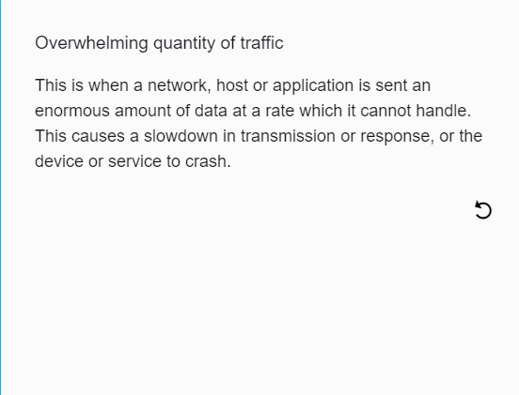
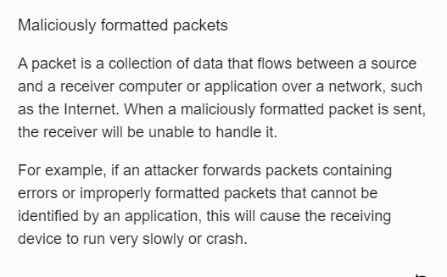
Denial-of-Service
Denial-of-Service (DoS) attacks are a type of network attack that is relatively simple to carry out, even by an unskilled attacker. A DoS attack results in some sort of interruption of network service to users, devices or applications. DoS attacks are considered a major risk because they can easily interrupt communication and cause significant loss of time and money. DOS can occur in two ways:

Slide 3
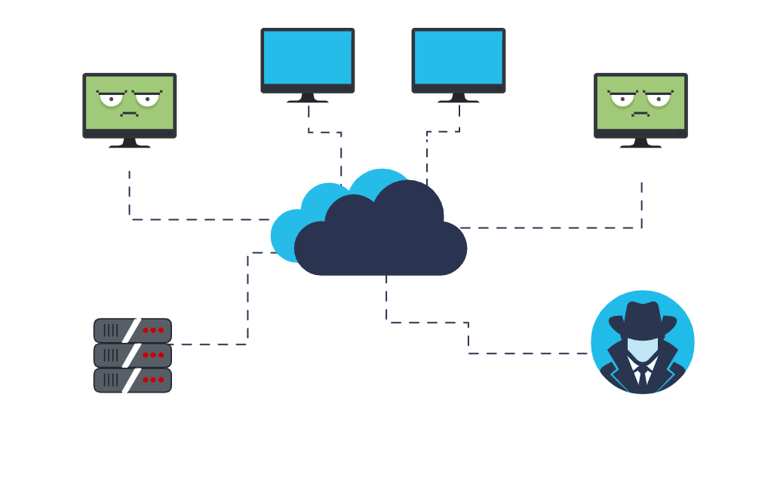
Distributed DoS
A Distributed DoS (DDoS) attack is similar to a DoS attack but originates from multiple, coordinated sources. For example:
An attacker builds a network (botnet) of infected hosts called zombies, which are controlled by handler systems.
The zombie computers will constantly scan and infect more hosts, creating more and more zombies.
When ready, the hacker will instruct the handler systems to make the botnet of zombies carry out a DDoS attack.

Slide 4
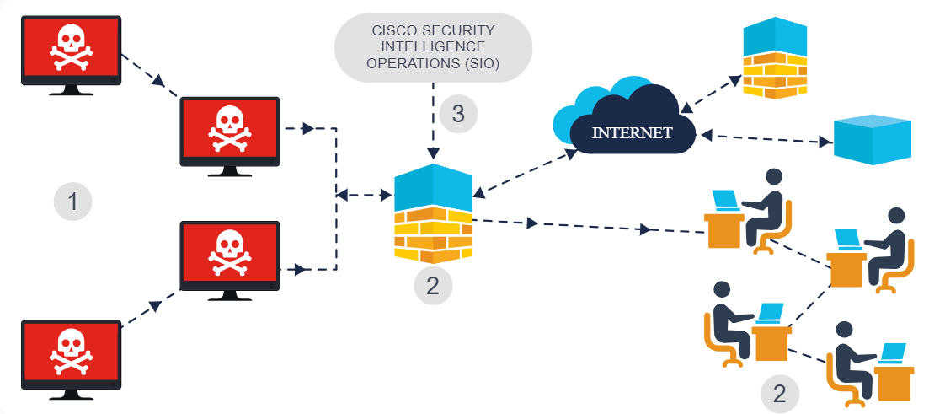
Botnet
A bot computer is typically infected by visiting an unsafe website or opening an infected email attachment or infected media file. A botnet is a group of bots, connected through the Internet, that can be controlled by a malicious individual or group. It can have tens of thousands, or even hundreds of thousands, of bots that are typically controlled through a command and control server.
These bots can be activated to distribute malware, launch DDoS attacks, distribute spam email, or execute brute-force password attacks. Cybercriminals will often rent out botnets to third parties for nefarious purposes.
Many organizations. like Cisco, force network activities through botnet traffic filters to identify any botnet locations.

Slide 5
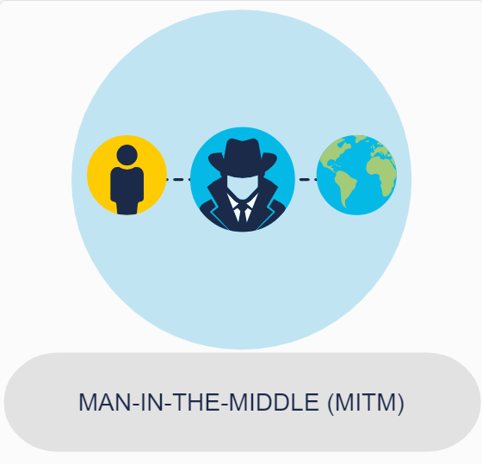
On-Path Attacks
On-path attackers intercept or modify communications between two devices, such as a web browser and a web server, either to collect information from or to impersonate one of the devices.
This type of attack is also referred to as a man-in-the-middle or man-in-the-mobile attack.
A MitM attack happens when a cybercriminal takes control of a device without the user's knowledge. With this level of access, an attacker can intercept and capture user information before it is sent to its intended destination. These types of attacks are often used to steal financial information. There are many types of malware that possess MitM attack capabilities.
MAN IN THE MIDLE (MOBILE)
A variation of man-in-middle, MitMo is a type of attack used to take control over a user's mobile device. When infected, the mobile device is instructed to exfiltrate user-sensitive information and send it to the attackers. ZeuS is one example of a malware package with MitMo capabilities. It allows attackers to quietly capture two-step verification SMS messages that are sent to users.

Slide 6

SEO Poisoning
You’ve probably heard of search engine optimization or SEO which, in simple terms, is about improving an organization’s website so that it gains greater visibility in search engine results.
Search engines such as Google work by presenting a list of web pages to users based on their search query. These web pages are
ranked according to the relevancy of their content.
While many legitimate companies specialize in optimizing websites to better position them, attackers take advantage of popular search
terms and use SEO to push malicious sites higher up the ranks of search results. This technique is called SEO poisoning.
The most common goal of SEO poisoning is to increase traffic to malicious sites that may host malware or attempt social engineering.

Slide 7
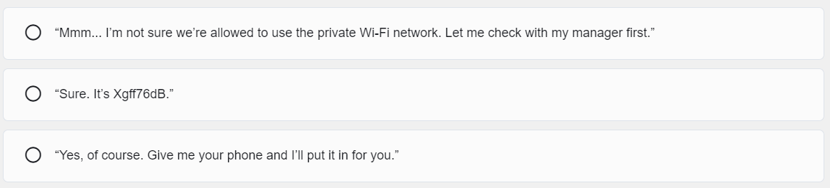
Wi-Fi Password Cracking
Wi-Fi password cracking refers to the process of attempting to gain unauthorized access to a Wi-Fi network by deciphering or circumventing its password protection. In cybersecurity, this practice is often used by attackers seeking to exploit vulnerabilities in wireless networks for malicious purposes.
You’re enjoying your lunch in the canteen when a colleague approaches you. They seem distressed.
They explain that they can’t seem to connect to the public Wi-Fi on their phone and ask if you have the private Wi-Fi password to hand so that they can check that their phone is working.
How would you respond?

Slide 8

Password Attacks
Entering a username and password is one of the most popular forms of authenticating to a web site. Therefore, uncovering your password is an easy way for cybercriminals to gain access to your most valuable information.
A password attack is any attempt to exploit a vulnerability in user authorization within a digital system. And just as there are a near-infinite number of possible passwords, there are many different methods that a cybercriminal may employ to maliciously authenticate into a secure account.

Slide 9
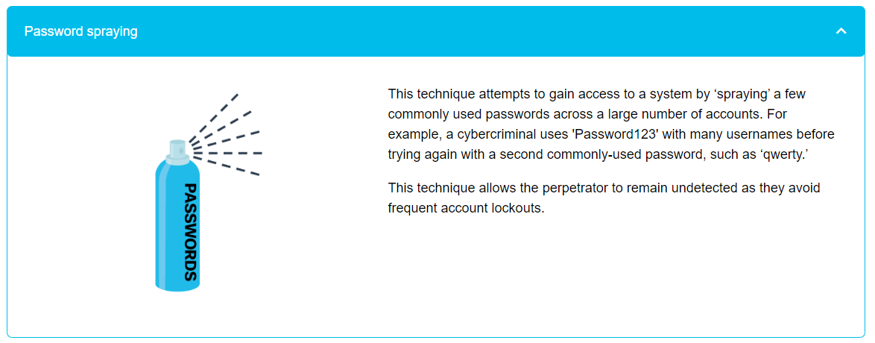
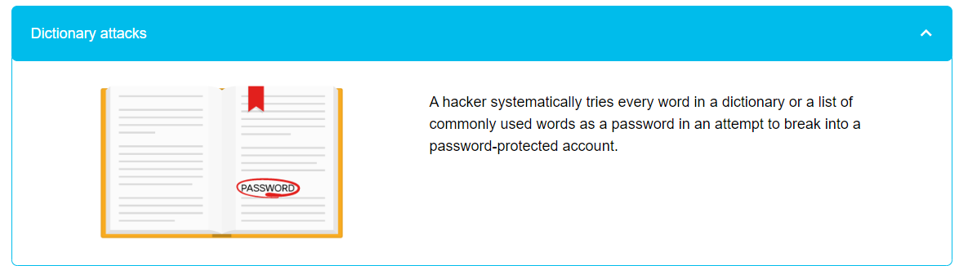

Slide 10
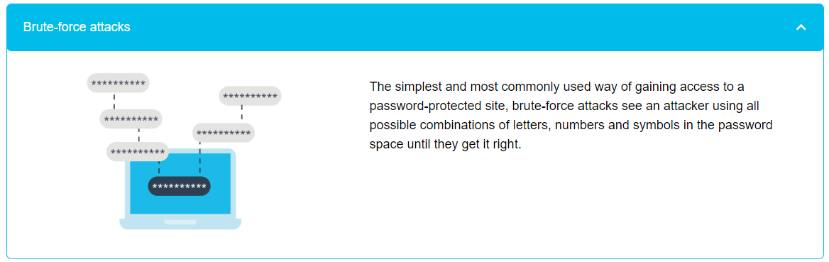
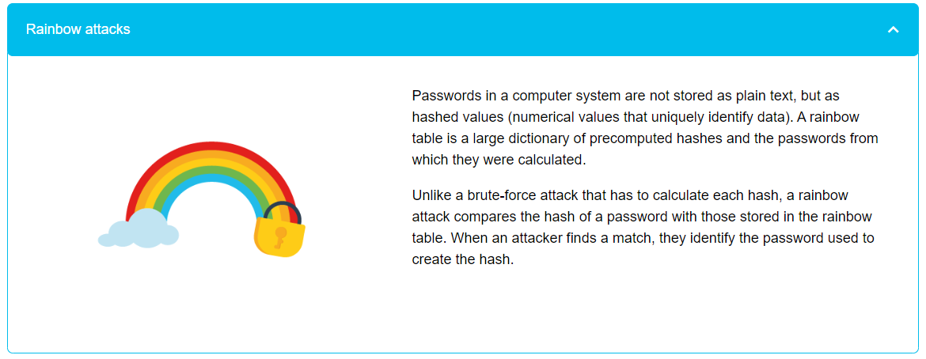

Slide 11

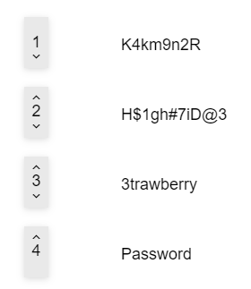
Quiz
It looks as if the hackers are trying everything to crack @Apollo’s private Wi-Fi password. We have to make sure that the password is strong enough to withstand their attack!
Take a look at the following passwords. Put them in the correct order according to how long you think it would take an attacker to crack each one using brute-force, where 1 is the shortest amount of time and 4, the highest.

Slide 12
QUIZ
On your way into the office, a person whom you have never seen before asks you to hold the door — they forgot their access card (DoS / SEO poisoning / Social engineering)
You searched for @Apollo’s website on Google, but when you clicked on the top result, you were redirected to a page advertising antivirus software (DoS / SEO poisoning / Social engineering)

Slide 13
Thank you for your time 😊

Slide 14
Next Lesson 😊 > Communication in a Connected World > Networking and Data Transmission

